Slide 1


NourishAID
AI powered Nourish Network

Slide 2



What is NourishAID?
A web-based UI designed for leaders of hunger relief organizations, such as food bank administrators, to efficiently search for available food surplus in their area based on specific food types and quantities. By empowering food banks to actively seek out suitable donors, this platform enables them to proactively address their needs instead of relying solely on incoming donations that may be expired, unsuitable, or excessive.
The Nourish Network is an AzureML-based application created for the Microsoft AI Innovation Challenge: Hack for a Sustainable Planet executive challenge. Our target is to enhance resource allocation, reduce food waste, and ensure that food banks receive high-quality, relevant donations to better serve their communities.

Slide 3
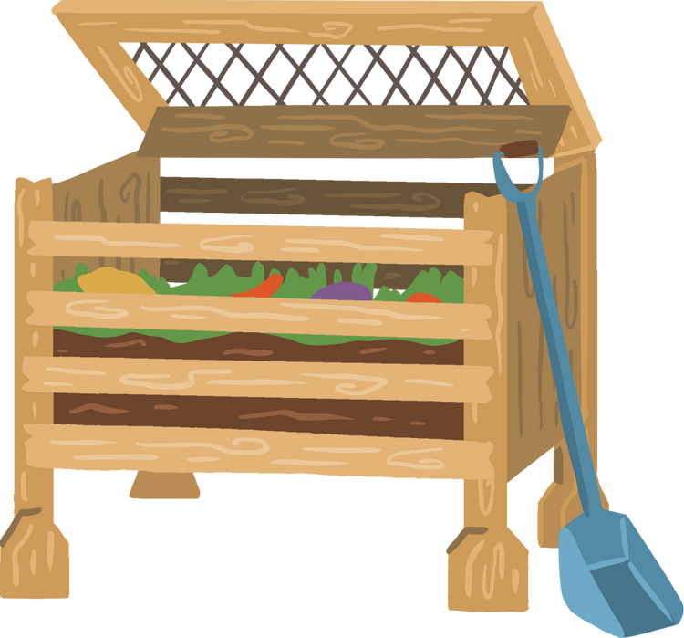
Social and Environmental Impacts of Food Waste
30-40% of the US food supply, approximately 133 billion pounds, is wasted annually. *
.
In 2022, An estimated 13.5% or 44,000,000 people in the US were food insecure. **
6% – of greenhouse gas emissions come from food that is lost in supply chains or wasted by consumers.***
1. Feeding America. (n.d.). *Map the meal gap*. https://map.feedingamerica.org/
2. Our World in Data. (n.d.). *Food waste emissions*. https://ourworldindata.org/food-waste-emissions
3. U.S. Food and Drug Administration. (n.d.). *Food loss and waste*. https://www.fda.gov/food/consumers/food-loss-and-waste

Slide 4

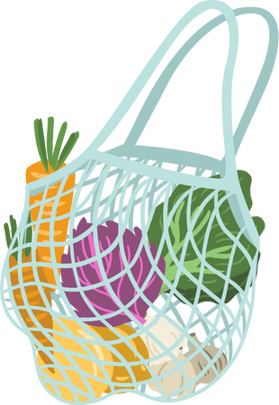

Case Study
For this project, we explored large-scale hunger relief models from Feeding America and the Capital Area Food Bank. The current model for redistributing food surplus is donor-initiated, placing the burden on donors to facilitate engagement, leaving a major gap in food donations.
In 2023, The Capital Area Food Bank in Washington, D.C., distributed 60.9 million meals, of which ~52%, 31.6 million were purchased.
The Nourish Network aims to reduce these expenses. Even a 5% increase in surplus donations alone could yield 1 million additional meals and save $40 million annually in D.C., addressing critical gaps.
This significant dependence on purchased meals resulted in $95,943,433 in food costs.
Capital Area Food Bank. (2024). *Hunger report 2024*. https://hunger-report.capitalareafoodbank.org/report-2024/

Slide 5





NourishAID Solution
A gap exists in coordinating resources between donors and food banks, leaving some under-supplied. NourishAID aims to streamline this, boosting donations and reducing operational costs for hunger relief. Currently, donors with excess supply reach out to food banks when they want to donate. We want to shift this to a consumer-initiated model, where food banks can request resources based on forecasted surplus.
Connect
Bridge organizations with food donors from different sectors based on location.
Predict
Leverage historical data and predictive algorithms, empowering organizations to choose their donations.
Optimize
Reduce the burden on donors by improving method of food distribution.

Slide 6

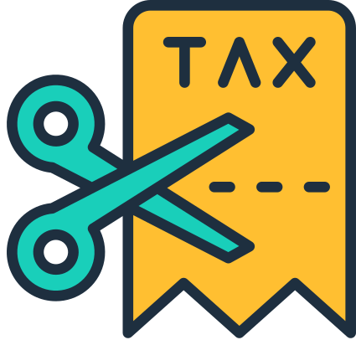

Incentives for Businesses
Offset Food Waste and Disposal Costs
Participation reduces food waste and burden of waste disposal or surplus management.
Tax Incentives
Businesses that donate food to qualified non-profits can receive significant tax benefits.
Cross-Industry Participation
Designed to be accessible for all food industry sectors—retail, manufacturing, farming, food service, and beyond—fostering an inclusive, consumer-initiated surplus distribution network.

Slide 7
Research Methodology
Objective: Create a solution that analyzes historical data on food surplus and scarcity to predict potential excess, enabling better coordination for upcycling and donation.
Research Design: A mixed-method approach was used to inform this project:
Qualitative Analysis: We researched statistics on food insecurity and waste to identify gaps this model could address. We also conducted phone interviews with representatives from Feeding America, Capital Area Food Bank (D.C.), and The Food Bank for New York City to the financial and social impacts of the current donor-initiated model.
Quantitative Analysis: Collected data on food surplus opportunities, waste levels, population demographics, and food insecurity rates. This data provides the foundation for our model to make predictions based on key factors contributing to food waste.
Data Collection
U.S. EPA Excess Food Opportunities Map.
REFED - Food Waste Monitor.
US Census Bureau. State Population Totals and Components of Change: 2020-2023.
U.S. Department of Agriculture. Prevalence of food insecurity average 2021-2023 by state.
Data Cleaning/Prep/ Feature Engineering: We assessed individual .csv files for data quality, errors, and missing values. Created additional features such as month, season, and proximity to food suppliers to enhance model accuracy. Integrated all data into a consolidated file for model training.
.
Data Storage: Training data was uploaded to Azure Blob Storage for use later in the Machine Learning Studio.
Ethical Considerations: All organizations interviewed provided informed consent before participating, and only publicly accessible financial and donor data were used. No private information on hunger relief organizations, donors, or food recipients was collected. We excluded demographic factors, such as race, criminal history, job type, and education level, to prevent bias, inequitable access, and data misuse. Transparency and accountability were prioritized to build trust, improve the model, and assess real-world impact. We carefully considered the model's effect on communities receiving donations, ensuring shelf life and recall information is available to protect vulnerable groups. Additionally, we evaluated potential impacts on small food producers, with further research needed to assess long-term effects on their businesses.
Limitations: Due to time constraints, data collection was limited by the labor-intensive preparation process, so we prioritized sources with the most relevant and comprehensive information. Live food surplus data was unavailable, so further research is needed to identify additional correlating data points to enhance data volume and improve model predictions.

Slide 8
Model Selection and Training
Training Models
Multi-Regression: Created to improve accuracy, stability, and error handling.
Boosted decision tree: This model was used to achieve high accuracy with our complex data set and reduce prediction errors.
Fast Forest: This model was used to provide insights into the importance of different features to help understand how different factors impact surplus.
Decision forest: This model was used to help manage issues with overfitting to improve accuracy.
Simple Regression: This model allows us to use less resources and provides an accurate predictive model.
Boosted decision tree.
Scoring Model: The Real Time Inference algorithm makes predictions instantly as new data becomes available, this provides the best use case for Nourish that requires immediate decision-making and responsiveness to match organizations with donors.
Visualization: Azure Maps to visualize prediction output of recommended facilities in a simple web UI.

Slide 9
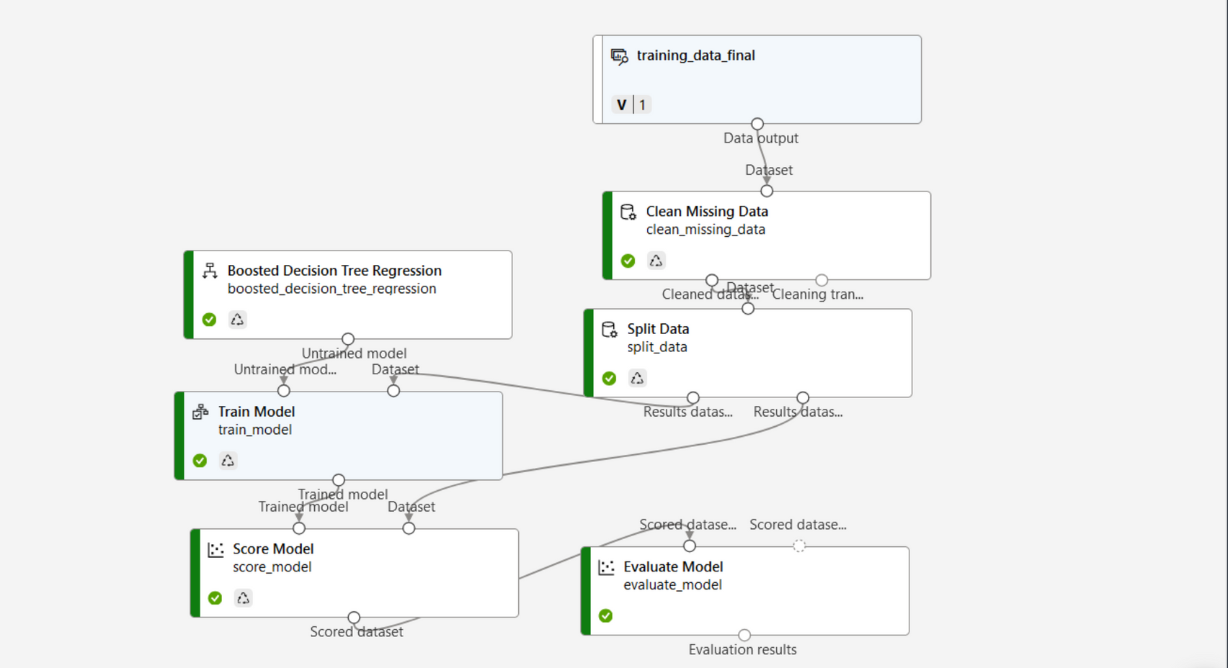
Simple Training Pipeline

Slide 10
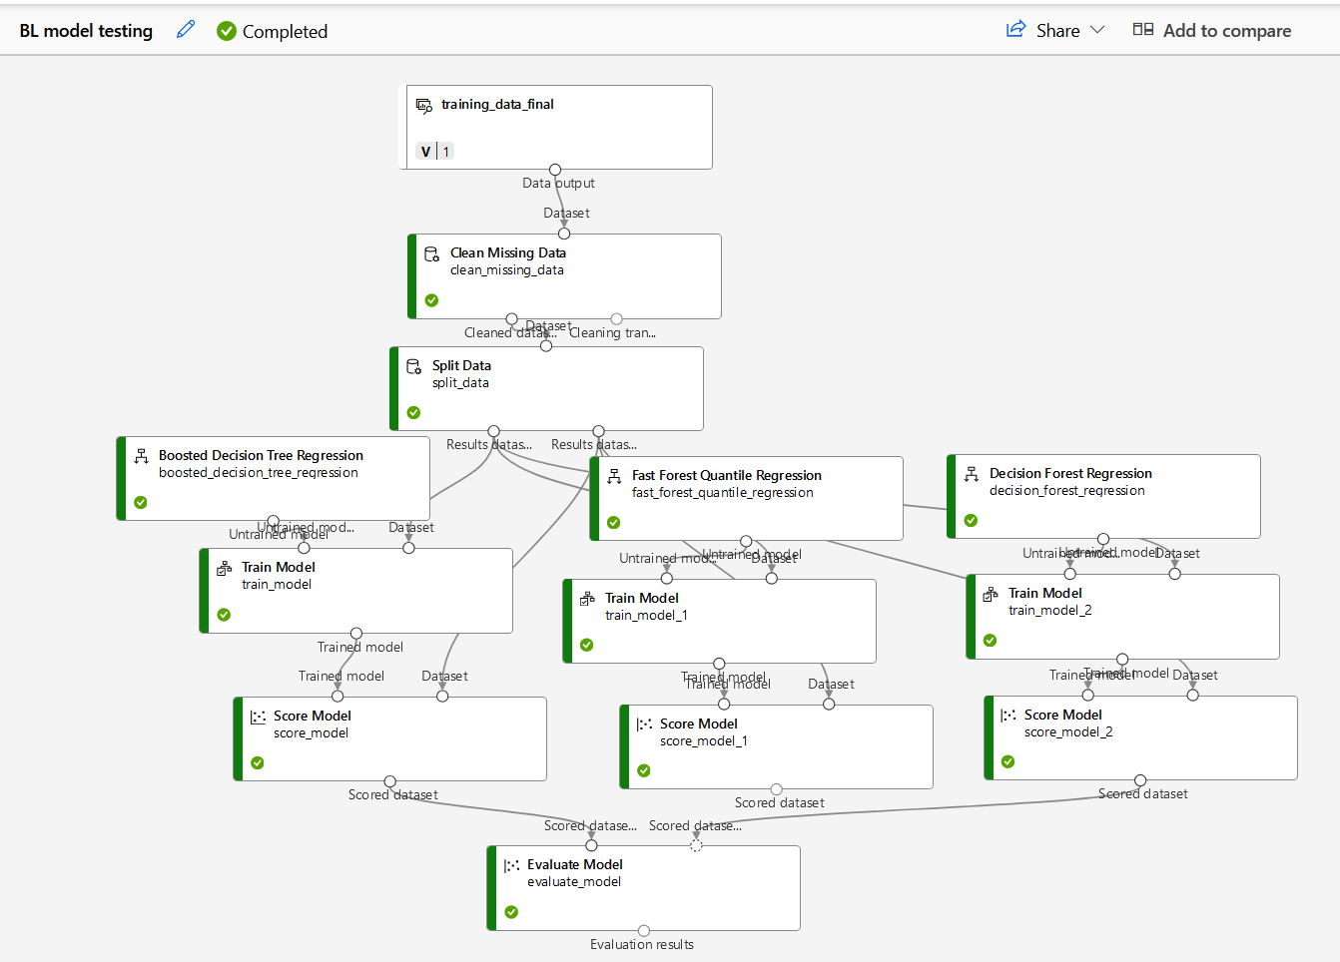
Multi-Regression Training Pipeline

Slide 11
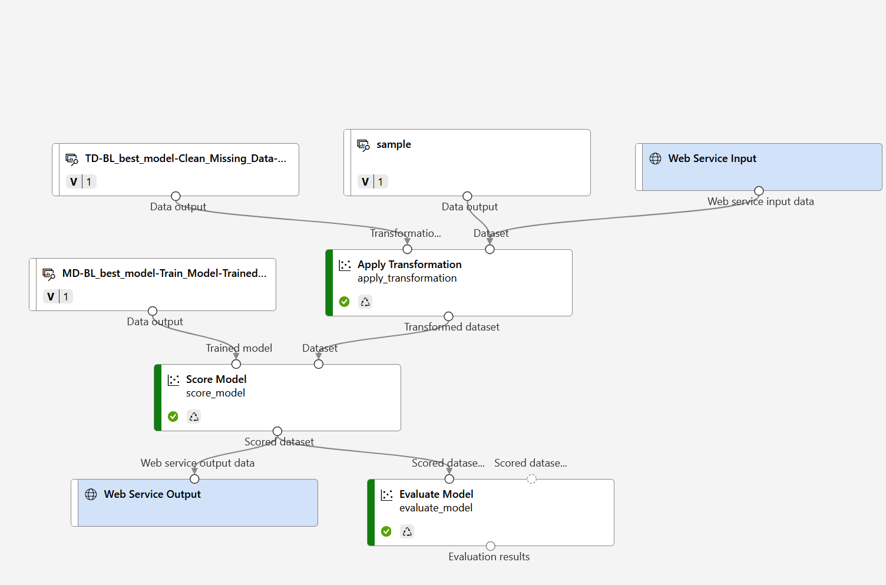
Prediction Pipeline

Slide 12
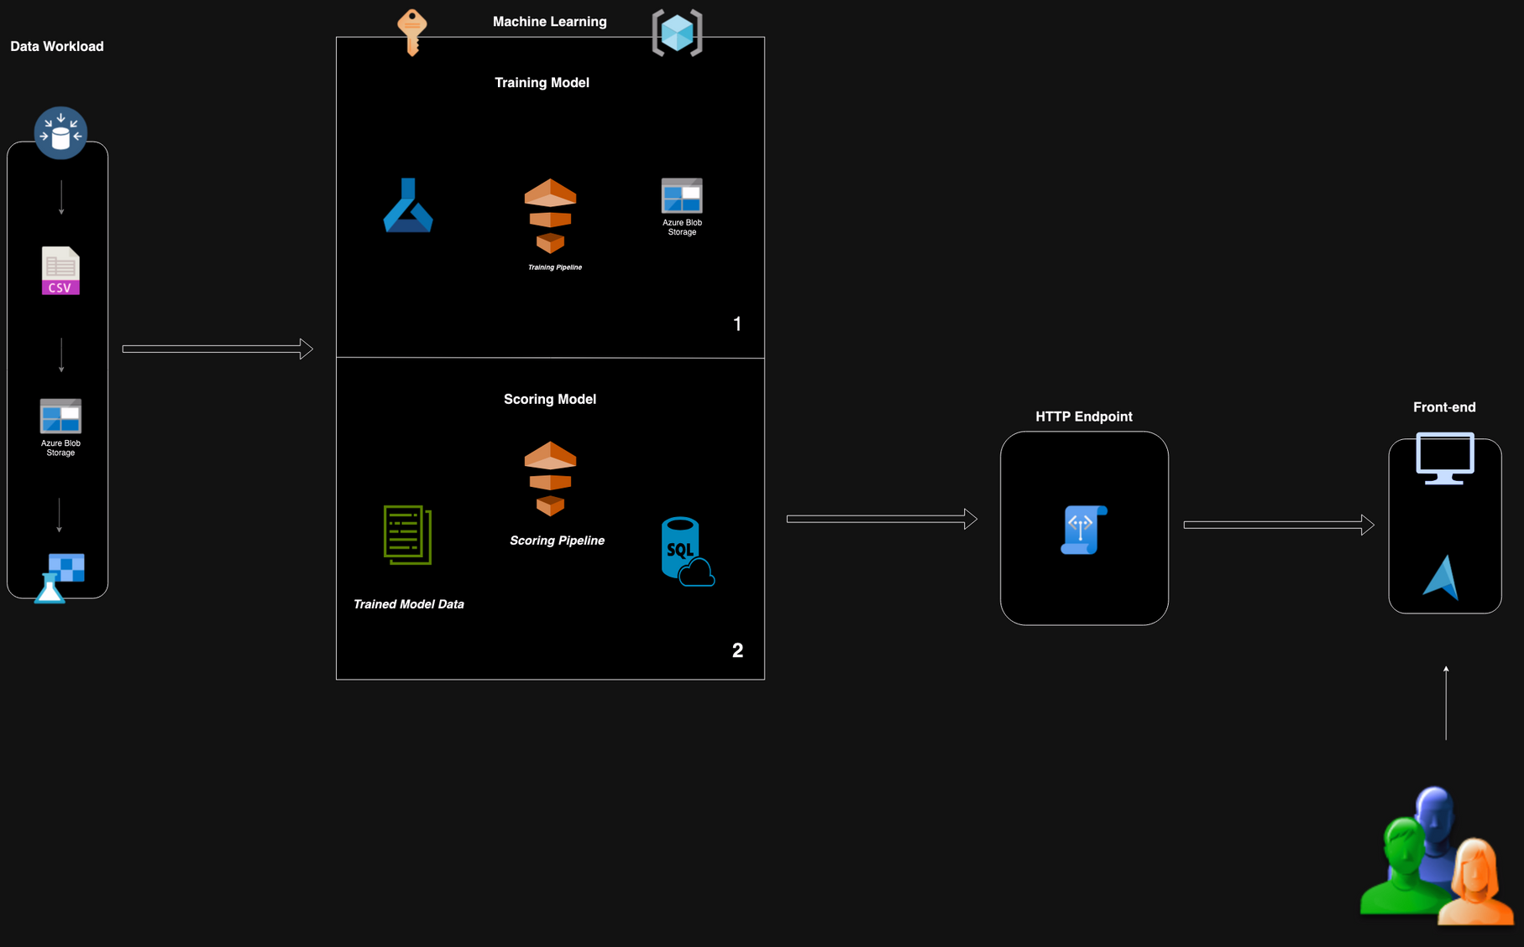
Architecture

Slide 13
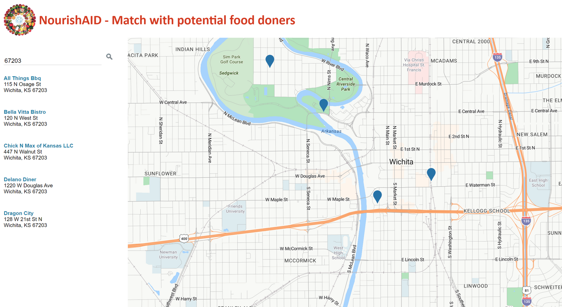

Slide 14
Responsible AI
Energy Usage
We opted for lightweight models over deep learning or neural networks. A cost-benefit analysis determined that a heavier model was unnecessary and wasteful.
Utilizing clean and concise data sources enhances storage efficiency and reduces overall energy consumption.
Privacy and Security
No personally identifiable information (PII) is collected during the data stage. Users' inputs will not be stored, and personal accounts are not required.
In further improvements implementation of robust cloud security measures to protect resources and ensure web application security to prevent potential exploitation, has been considered.
Bias Mitigation
We will evaluate model performance across various communities, regions, and demographic groups to ensure fairness and avoid favoring urban areas over rural ones.
Model Transparency
We commit to providing clear documentation of our research methodology, an architecture diagram, and sources of data to ensure transparency.
Responsible Deployment and Use
We engaged with hunger relief leaders throughout the research phase, we would like to include them in the deployment process to ensure the application meets their needs and aligns with their operational practices.
Monitoring and Testing
Assessing whether the application creates a real-world impact and identify areas for improvement based on user feedback and outcomes.

Slide 15
Future Work and Improvements
Improve Feature Engineering: To more accurately forecast food surplus and match donations to areas of need, integrating the following features will capture complex patterns across time, geography, and socioeconomics.
Storage available at receiving food bank: Not all food banks are resourced with adequate refrigeration, including this feature would allow food banks to select from food types that fit their storage needs.
Fridge, Pantry,etc.
Temporal Features: This will factor in how seasons impact food variety available, day of week will inform peak availability patterns across a week, and holidays will allow us to predict increased food needs or food unavailability.
Season, Day of the week, holidays
Geographic and Demographic Features: These features will help better predict need from food banks.
Population density, median income, proximity to other food sources.
Supply Chain: Allow up to predict surplus over time.
Inventory Levels
Historical donation frequency
Environmental Factors: How does weather impact food surplus and need? How does natural disaster create spikes in need?
Weather Data
Energy Monitoring Tools
Include tools that can monitor energy consumption during model training, deployment, and use. To help identify inefficiencies and areas for optimization.
Hurdles, Key Takeaways, and Next steps
Limited Data Sources
The availability of limited historical and live data sources restricted the associations we could make during the data preparation phase, which posed significant challenges in building an effective model. Informing the need for more detailed research into data sources.
Deployment Challenges
We encountered difficulties in deploying the model to an online endpoint for visualization, highlighting the need for better preparation and planning for the deployment process.
End to End Solution
Since we were unable to

Slide 16

NourishAID Team
Stacey Haack
Michelle M.
Gayatree Vaidya
Michelle Opoku
Rebecca Lorig

